Slide 1
Society of Industrial and Office REALTORS

Slide 2
Today’s Discussion
SIOR: What’s in it for you?
SIOR: How to earn your designation?
SIOR: LET THE POWER OF THE GLOBAL NETWORK WORK FOR YOU

Slide 3
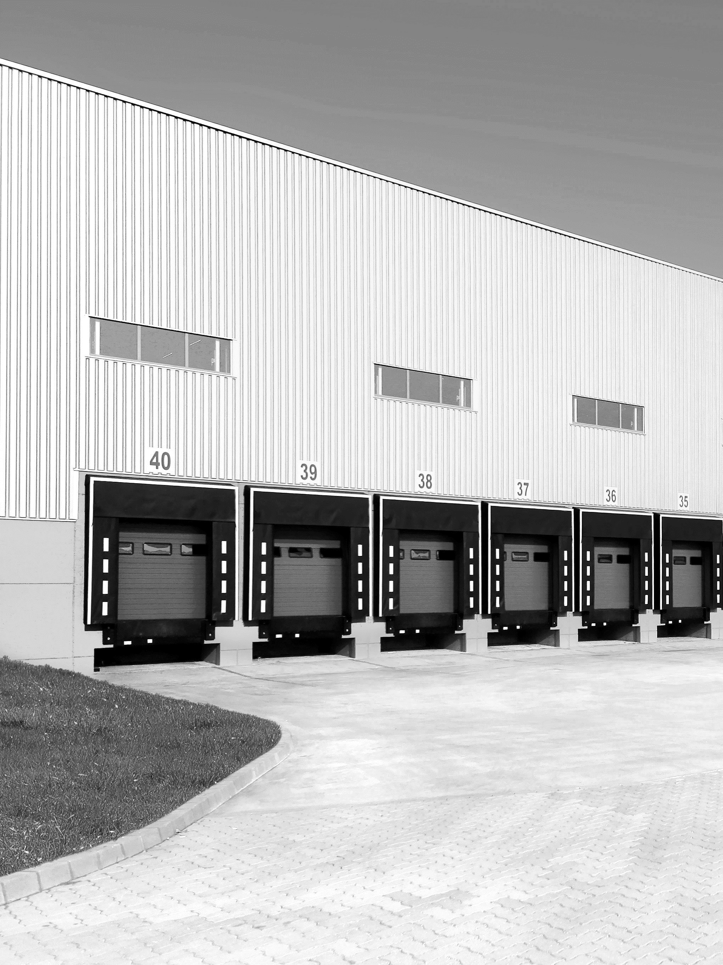
SIOR: What’s in it for you?
SIOR at a glance
Value of SIOR and the designation
SIOR: LET THE POWER OF THE GLOBAL NETWORK WORK FOR YOU
3

Slide 4
SIOR at a Glance
SIOR is the leading industrial and office real estate brokerage association.
SIOR confers the SIOR designation to only the most knowledgeable, experienced, ethical, and successful commercial real estate brokerage specialists.
SIOR: LET THE POWER OF THE GLOBAL NETWORK WORK FOR YOU
3

Slide 5
SIOR at a Glance
SIOR: LET THE POWER OF THE GLOBAL NETWORK WORK FOR YOU

Slide 6
SIOR at a Glance
SIOR is the leading industrial and office real estate
brokerage association.
SIOR confers the SIOR designation to only the most
knowledgeable, experienced, ethical, and successful
commercial real estate brokerage specialists.
3,200 Members
3,000 SIOR Designees
1,900 Industrial Brokers
1,100 Office Brokers
200 Associate Members
Developers
Financial Institutions
Commercial Real Estate Organizations
SIOR: LET THE POWER OF THE GLOBAL NETWORK WORK FOR YOU

Slide 7
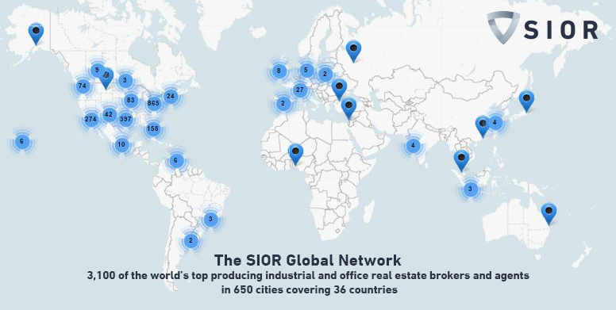
SIOR at a Glance
SIOR: LET THE POWER OF THE GLOBAL NETWORK WORK FOR YOU

Slide 8
SIOR- A Respected Authority
SIOR Commercial Real Estate Index - indicator of up to date market conditions.
The SIOR Report - quarterly print and digital magazine with timely and relevant articles.
Advocacy – a voice in Washington.
Arbitration, and Mediation - peer based systems for resolving business disputes.
SIOR: LET THE POWER OF THE GLOBAL NETWORK WORK FOR YOU

Slide 9
SIOR is the leading industrial and office real estate
brokerage association.
SIOR confers the SIOR designation to only the most
knowledgeable, experienced, ethical, and successful
commercial real estate brokerage specialists.
Impact of the SIOR Designation
“My SIOR designation has allowed me to brand myself as a top professional in the commercial real estate industry. As an independent broker and now as part of a national company, SIOR is my network that goes with me everywhere.”
Allen Gump, SIOR, CCIM
Colliers International
Dallas, Texas
Instant credibility
Industry prestige
Tangible evidence of expertise
Broader referral network
SIOR: LET THE POWER OF THE GLOBAL NETWORK WORK FOR YOU

Slide 10
What Sets SIOR Apart
SIOR Designees are:
Specialists in industrial and office markets.
“Deal Doers” recognized by developers, lenders, and investors.
Top producing professionals – closing on average 30 transactions per year.
The Best of the Best – fulfilled significant production, education, and ethical requirements.
SIOR: LET THE POWER OF THE GLOBAL NETWORK WORK FOR YOU

Slide 11
SIOR and a Large Firm or Network (Optional Slide)
Individual designation and achievement
Differentiate yourself within your firm
Broader referral network
Additional industry perspective and resource
SIOR: LET THE POWER OF THE GLOBAL NETWORK WORK FOR YOU

Slide 12
SIOR is the leading industrial and office real estate
brokerage association.
SIOR confers the SIOR designation to only the most
knowledgeable, experienced, ethical, and successful
commercial real estate brokerage specialists.
Enhance Your Professional Revenue
Develop relationships with the best brokers to share information, best practices, and ultimately refer business.
SIOR: LET THE POWER OF THE GLOBAL NETWORK WORK FOR YOU

Slide 13
Enhance Your Professional Revenue
“SIOR has been invaluable in executing client assignments. SIOR is the first contact we make in every city we visit for local market expertise and insight.“
John Robbins, SIOR, FRICS, Carpenter/Robbins Commercial Real Estate Inc., San Ramon, California
Brokers and clients seeking services in your market will recognize your SIOR designation - giving you instant credibility.
SIOR: LET THE POWER OF THE GLOBAL NETWORK WORK FOR YOU

Slide 14
SIOR is the leading industrial and office real estate
brokerage association.
SIOR confers the SIOR designation to only the most
knowledgeable, experienced, ethical, and successful
commercial real estate brokerage specialists.
Enhance Your Professional Skills
"You can send out all the Tweets, Blogs, Linked-ins, email blasts and text messages that you want but one handshake at a conference will cement a relationship for life."
Doug Brockhouse, SIOR, CCIM, Bender Commercial Real Estate Services,
Sioux Falls, South Dakota
SIOR World Conferences feature top speakers and excellent educational sessions.
Chapter programs keep you locally connected and informed.
SIOR: LET THE POWER OF THE GLOBAL NETWORK WORK FOR YOU

Slide 15
How to Earn your Designation
Membership Specialist Classifications
Qualifications
Admissions Process
SIOR: LET THE POWER OF THE GLOBAL NETWORK WORK FOR YOU

Slide 16
Earning Your Designation - Specialties
The SIOR designation is granted in one of six specialist classes:
Industrial
Office
Industrial & Office (Dual)
SIOR: LET THE POWER OF THE GLOBAL NETWORK WORK FOR YOU

Slide 17
Earning Your Designation - Specialties
The SIOR designation is granted in one of six specialist classes:
Advisory Services – consultant or advisory practitioner
Executive – manage 100+ agents in three or more offices
Sales Management – manage at least 10 sales or leasing agents
SIOR: LET THE POWER OF THE GLOBAL NETWORK WORK FOR YOU

Slide 18
Earning Your Designation- Qualifications
Designation requirements for a broker in Canada, Mexico, or USA:
Experience
Production - Gross Fee Income (GFI)
Education
Endorsements
Ethics
SIOR: LET THE POWER OF THE GLOBAL NETWORK WORK FOR YOU

Slide 19
Designation Qualifications- Experience
Experience:
5 years minimum commercial real estate brokerage experience.
Exception:
10 years minimum management experience for Executive specialists.
SIOR: LET THE POWER OF THE GLOBAL NETWORK WORK FOR YOU

Slide 20
Designation Qualifications- Production
Gross Fee Income (GFI):
GFI is the amount that the applicant’s firm receives before splits that is directly attributable to the applicant.
GFI requirements are set by Chapters and range from $200,000 to $400,000* per year.
*New York City (Manhattan) is $500,000
SIOR: LET THE POWER OF THE GLOBAL NETWORK WORK FOR YOU

Slide 21
Designation Qualifications- Production
Industrial, Office, and Advisory Specialists
Minimum of 5 transactions per year.
Meet set GFI amount for 3 out of the 4 most recent 12-month periods.
At least 70% of the GFI requirement must be comprised of industrial and/or office transactions.
SIOR: LET THE POWER OF THE GLOBAL NETWORK WORK FOR YOU

Slide 22
Designation Qualifications- Production
Dual (Industrial & Office) Specialists
Minimum of 10 transactions per year.
Meets 2x the GFI requirement for 3 out of 4 most recent 12 month periods.
Industrial transactions must comprise an amount equal to at least 70% of the GFI requirement
Office transactions must comprise an amount equal to at least 70% of the GFI requirement.
SIOR: LET THE POWER OF THE GLOBAL NETWORK WORK FOR YOU

Slide 23
Designation Qualifications- Production
Sales Management Specialists
Multiply the GFI requirement by 10 agents and take 75% of the resulting figure = the yearly GFI requirement for 3 out of the 4 most recent 12 month periods.
The top 10 industrial and/or office brokers qualify.
At least 70% of the GFI requirement must be comprised of industrial and/or office transactions.
SIOR: LET THE POWER OF THE GLOBAL NETWORK WORK FOR YOU

Slide 24
Designation Qualifications- Production
Executive Specialists
Executive applicants are not required to meet GFI requirement.
SIOR: LET THE POWER OF THE GLOBAL NETWORK WORK FOR YOU

Slide 25
Designation Requirements - Education
Education
Demonstrate knowledge of industrial and office real estate by fulfilling one
of the following:
SIOR Coursework
Comprehensive Membership Entrance Exam
SIOR: LET THE POWER OF THE GLOBAL NETWORK WORK FOR YOU

Slide 26
Designation Requirements - Education
SIOR Coursework
Applicants complete three (3) mandatory courses.
Ethics & Professional Standards
Construction
Understanding the Lease Agreement
SIOR: LET THE POWER OF THE GLOBAL NETWORK WORK FOR YOU

Slide 27
Designation Requirements - Education
SIOR Coursework
Applicants complete minimum three (3) of the six (6) elective courses.
Advanced Sales Skills
Build-to-Suit Development
Consolidating a Business Strategy
Introduction to Real Estate Investment and Finance (taken online)
Negotiation Skills
Tenant and Landlord Representation
SIOR: LET THE POWER OF THE GLOBAL NETWORK WORK FOR YOU

Slide 28
Designation Requirements - Education
SIOR Coursework – Alternative ways to earn elective course credit
CCIM Designation - 3 elective courses and fulfills elective requirement
CCIM Courses: 101, 102, 103, or 104 - 1 elective course each for a maximum of 2 elective courses
Graduate Degree in Real Estate, Business or Law from an accredited college or university - 2 elective courses
SIOR: LET THE POWER OF THE GLOBAL NETWORK WORK FOR YOU

Slide 29
Designation Requirements - Education
SIOR Coursework – Alternative ways to earn elective course credit
CPM Designation - 2 elective courses
RPA Designation - 2 elective courses
FRI Designation - 2 elective courses
SIOR: LET THE POWER OF THE GLOBAL NETWORK WORK FOR YOU

Slide 30
Designation Requirements - Education
SIOR Coursework
The SIOR Center for Career Advancement offers Core Components of Commercial Brokerage courses three to four times a year.
Fulfill the education and ethics requirements over three days.
2018 Course Calendar: www.sior.com/education
SIOR: LET THE POWER OF THE GLOBAL NETWORK WORK FOR YOU

Slide 31
Designation Requirements - Education
Comprehensive Membership Entrance Exam
200 multiple-choice questions, plus five short essays.
Covers areas such as leasing, appraisal, tenant/landlord representation, sales skills, construction, investment, environmental issues, and SIOR's Professional Standards.
Ethics must fulfilled additionally through separate online course.
SIOR: LET THE POWER OF THE GLOBAL NETWORK WORK FOR YOU

Slide 32
Designation Requirements - Education
Education Fees
SIOR Course – Ranges from $990 - $1,650
Comprehensive Membership Exam – $2,000
SIOR: LET THE POWER OF THE GLOBAL NETWORK WORK FOR YOU

Slide 33
Designation Requirements- Endorsements
Two formal endorsements from SIOR designees in the applicant’s Chapter but not in the applicant’s firm or affiliate.
SIOR: LET THE POWER OF THE GLOBAL NETWORK WORK FOR YOU

Slide 34
Designation Requirements- Ethics
Applicants must uphold high ethical standards of practice and pledge to uphold SIOR’s Code of Ethical Principles and Standards of Professional Practice.
Satisfy the ethics requirement by completing either
Online Ethics course or
Ethics & Professional Standards course
SIOR: LET THE POWER OF THE GLOBAL NETWORK WORK FOR YOU

Slide 35
Earning your Designation- Admissions Process
Preparing an application
Submitting an application
Application review
New SIOR Member
SIOR: LET THE POWER OF THE GLOBAL NETWORK WORK FOR YOU

Slide 36
Earning your Designation- Admissions Process
Preparing an application
Applicant reviews qualifications.
Applicant confirms GFO amounts.
Managing broker or CFO completes and signs GFI Affidavit.
SIOR: LET THE POWER OF THE GLOBAL NETWORK WORK FOR YOU

Slide 37
Earning your Designation- Admissions Process
Submitting an application
Online application completed with GFI Affidavit submitted to SIOR Headquarters.
Chapter reviews application and conducts interview with applicant.
Admissions Manager notifies Chapter membership and invites comments.
SIOR: LET THE POWER OF THE GLOBAL NETWORK WORK FOR YOU

Slide 38
Earning your Designation- Admissions Process
Application review
Applicant obtains two endorsements and remits to Manager of Admission.
Vote for approval by SIOR Council of Chapter Presidents.
Welcome to SIOR!
SIOR: LET THE POWER OF THE GLOBAL NETWORK WORK FOR YOU

Slide 39
Earning your Designation- Admissions Process
New SIOR member
Attend an SIOR World Conference – first one is complimentary
Get involved with the local chapter.
Get involved with the local Chapter.
Participate as an active member.
SIOR: LET THE POWER OF THE GLOBAL NETWORK WORK FOR YOU

Slide 40
Membership Fees
Online Application - $175
Initiation Fee - $725 (one-time fee)
Annual Membership Dues - $1,345 (first year is prorated)
SIOR: LET THE POWER OF THE GLOBAL NETWORK WORK FOR YOU

Slide 41
Questions
Get involved with the local Chapter.
SIOR: LET THE POWER OF THE GLOBAL NETWORK WORK FOR YOU

Slide 42
Contacts to Assist You
Michael Topp, Director of Membership
Phone: 202.449.8216
Email: mtopp@sior.com
Ying-Ying Chow, Manager of Admissions
Phone: 202.449.8234
Email: ychow@sior.com
SIOR: LET THE POWER OF THE GLOBAL NETWORK WORK FOR YOU

