Slide 2
3

Slide 3
3

Slide 4
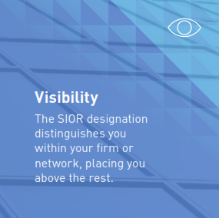
3

Slide 7
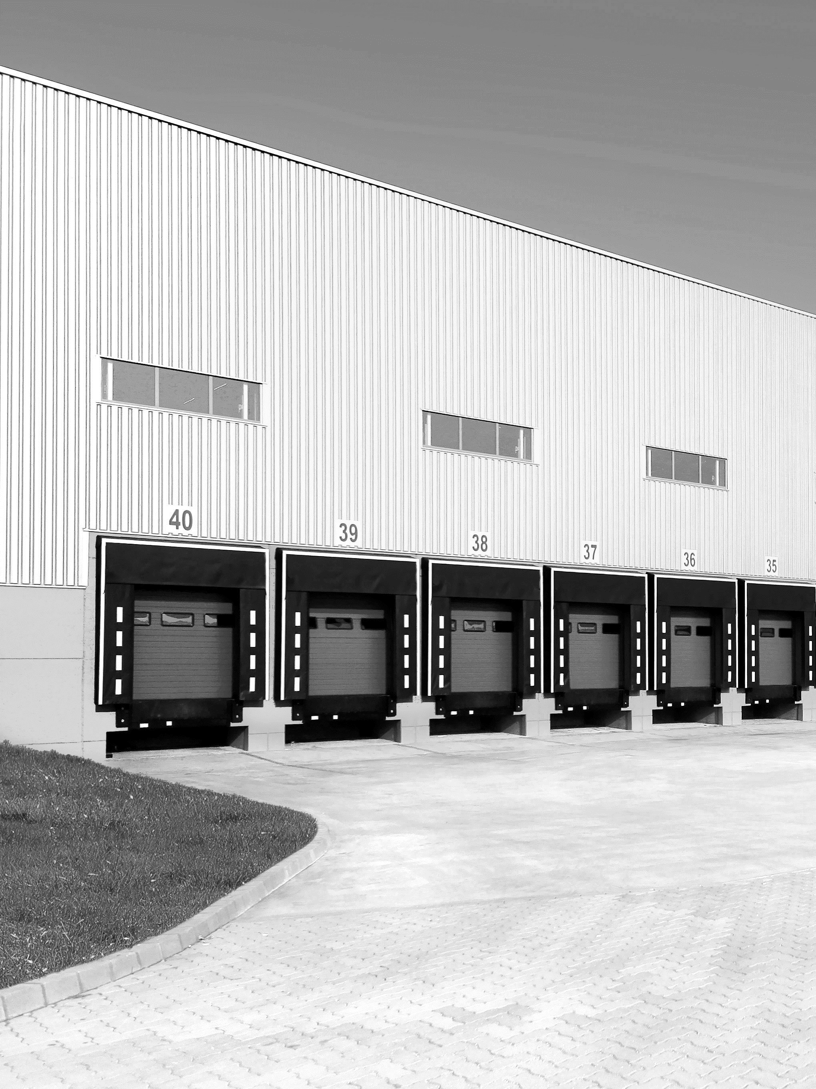
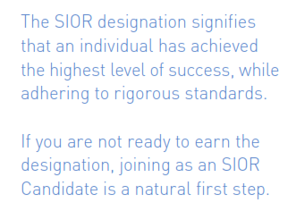
SIOR is the leading industrial and office real estate
brokerage association.
SIOR confers the SIOR designation to only the most
knowledgeable, experienced, ethical, and successful
commercial real estate brokerage specialists.

Slide 8
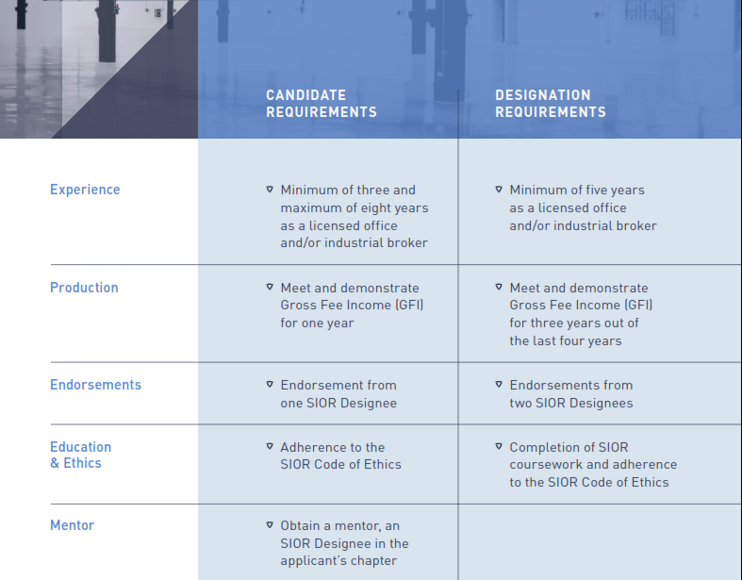
SIOR is the leading industrial and office real estate
brokerage association.
SIOR confers the SIOR designation to only the most
knowledgeable, experienced, ethical, and successful
commercial real estate brokerage specialists.

Slide 9
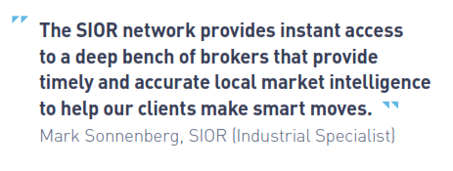
SIOR is the leading industrial and office real estate
brokerage association.
SIOR confers the SIOR designation to only the most
knowledgeable, experienced, ethical, and successful
commercial real estate brokerage specialists.

Slide 10
www.sior.com

